Slide 1
it is not a compliment.
Lucy M Bonner
Major Studio I
Final Project Proposal

Slide 2
I am studying street harassment because I want to find out how to represent the forceful intrusion & violation of space & attention that makes a woman feel vulnerable, angry, and silenced in order to effect change.

Slide 3
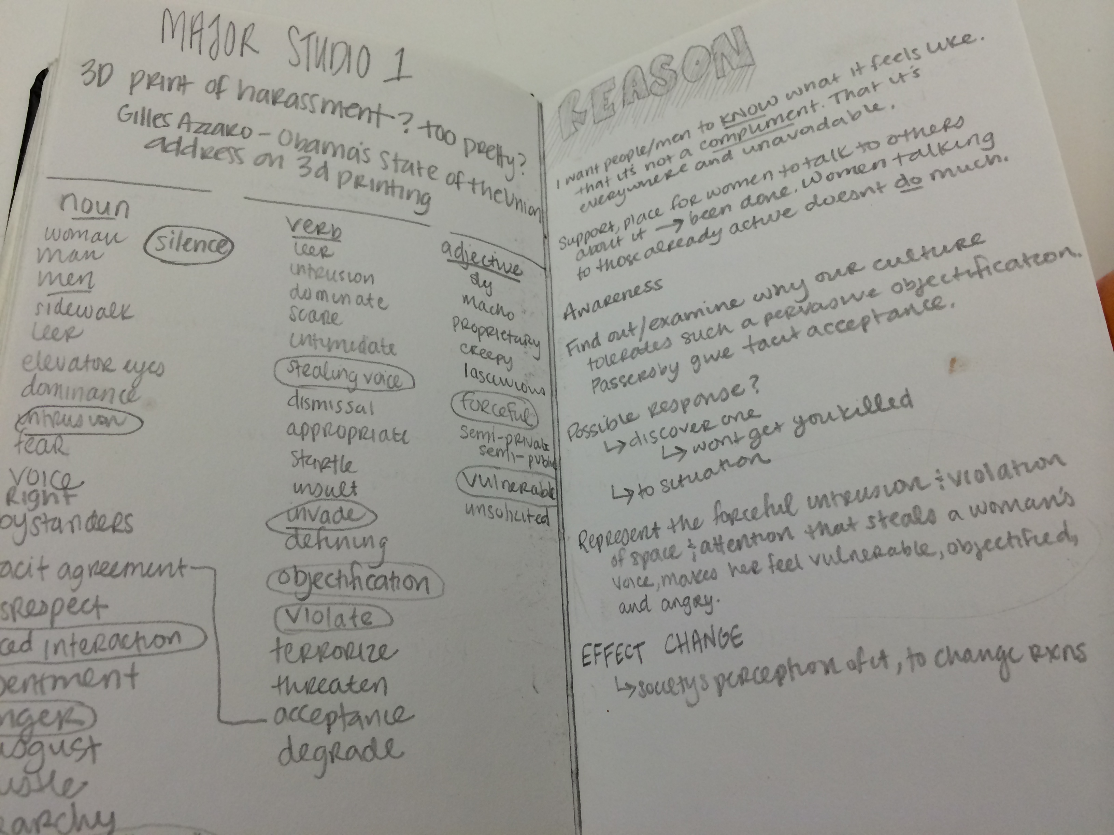
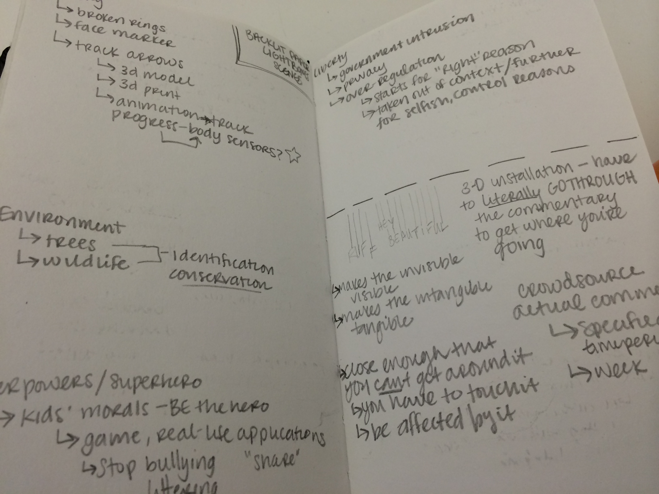
domains
Street Harassment
Social Conventions
Interpersonal Interactions
Feminism
Feelings of
Violation
Intrusion
Objectification
Fear
Anger

Slide 4
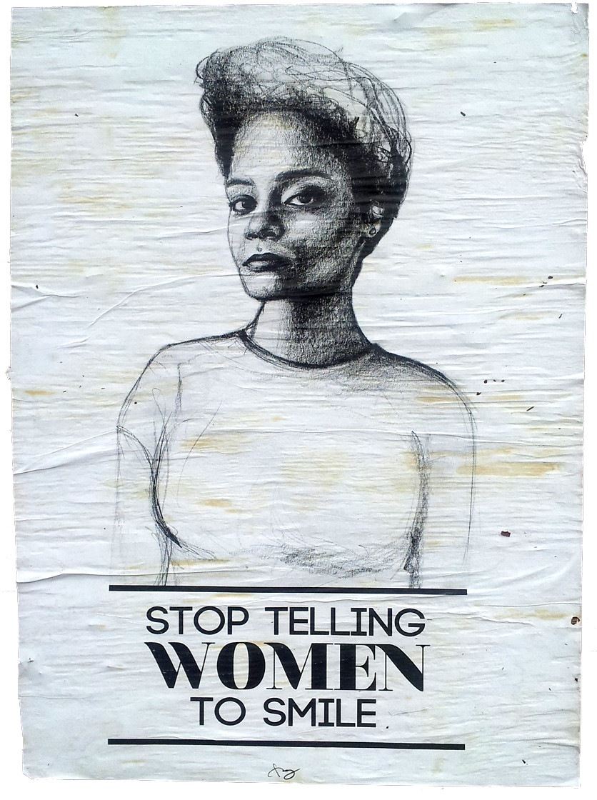
precedents
Street Harassment:
Stop Telling Women To Smile
Tatyana Fazlalizadeh
Catcalls Exhibit
Jenga Mwendo
“I Never Ask For It”
Blank Noise, India
Immersive Installations:
MoMA Gestation
MoMA Rain Room
Random International
Gun Country
Michel Murphy
BION
Adam W. Brown

Slide 5
audiences & contexts
The socially-conscious. The want-to-be-more-socially-conscious.
People who are unaware of what it feels like to be harassed.
Where, you ask? THE STREETZ. Or, more likely, the sidewalks.
Hallways.

Slide 6
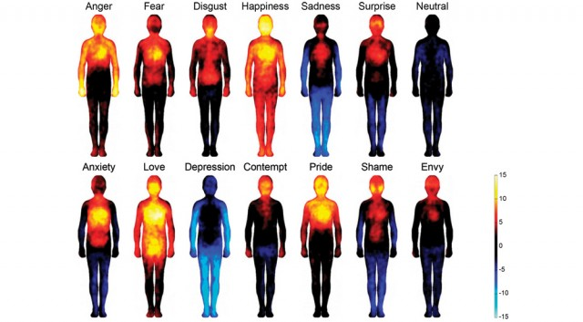

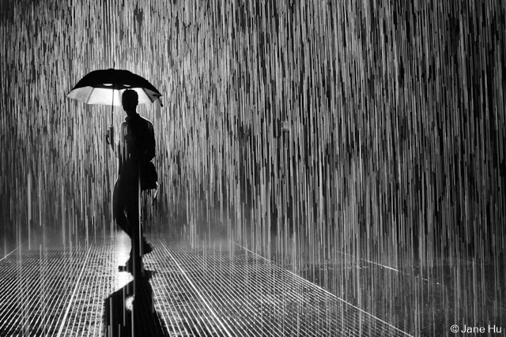
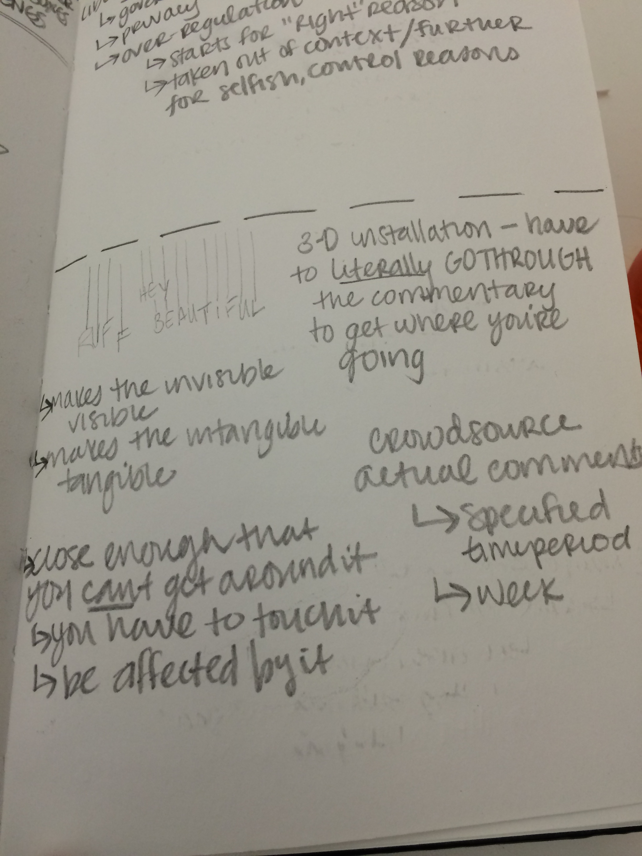
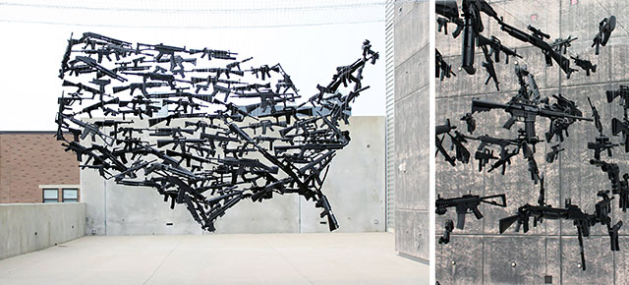
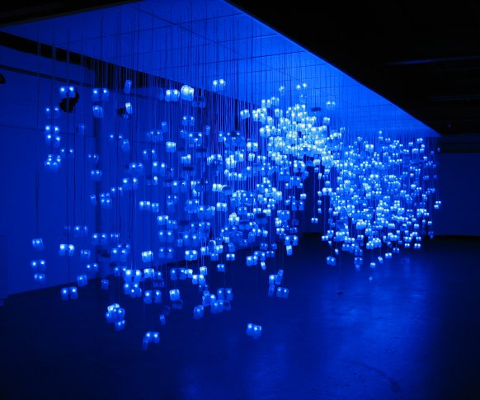
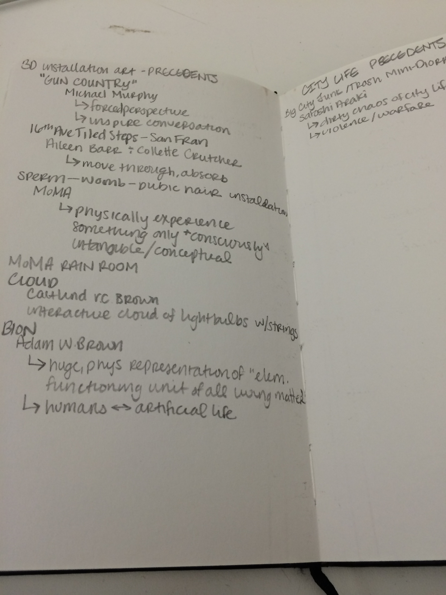
PROCESS
Immersive Installation Experience.
Making the intangible tangible and the invisible visible – a physical representation of auditory and emotional experience.
Designing options for the surrounding environment of the harassment – designing the physical interaction aspects - p.comp.

Slide 7
RESEARCH QUESTION
How can I represent
the forceful intrusion & violation of space & attention that makes a woman feel vulnerable, angry, and silenced
within a controlled space
and with a voluntary subject?
Can I really raise awareness and effect change in our societal beliefs about the importance of street harassment?

